Slide 1
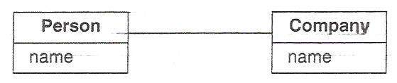

CS562WS DBMS II
CS574 Object-Oriented Analysis & Design
Multiplicity: Many-to-Many
In the following class diagram the “*” means “zero or more.”
* OwnsStockIn *
The association can, therefore, be read as “A person owns stock in zero or more companies, and stock in a company is owned by zero or more persons.”

Slide 2
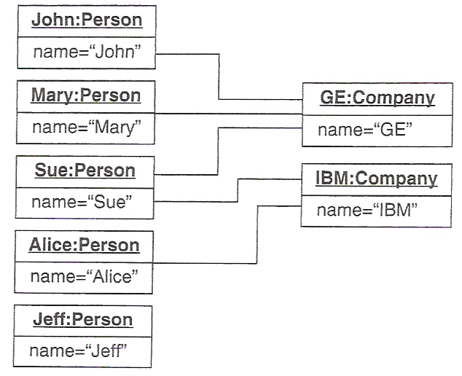
CS562WS DBMS II
CS574 Object-Oriented Analysis & Design
Multiplicity: Many-to-Many
The following object diagram is, therefore, consistent with the class diagram on the previous page.
OwnsStockIn
OwnsStockIn
OwnsStockIn
OwnsStockIn
OwnsStockIn

Slide 3

CS562WS DBMS II
CS574 Object-Oriented Analysis & Design
Multiplicity: (cont.)
The following class diagram (ignore the “{ordered}” for the moment), is intended to be an example of the use of * multiplicity on one side of an association but some other multiplicity on the other:
IsVisibleOn
*
The diagram is, presumably, for a windowing system or for an application with a GUI interface. According to my understanding, however, a screen can hold multiple windows rather than vice versa, so that a window is visible on a screen, rather than the other way around; this means that the author of the diagram has been sloppy in a way that puzzled me for a few minutes when I first saw it – a big waste of time. (If we were talking about a many-page design for a software application or system, this sort of sloppiness, especially if software has already been written from it, can cost hours or days or weeks or months of wasted time – and thousands and thousands of wasted dollars.)

Slide 4

CS562WS DBMS II
CS574 Object-Oriented Analysis & Design
Multiplicity: (cont.)
The problem discussed on the previous slide is fixed in the following diagram:
{ordered}
Window
Screen
*
IsVisibleOn
1
Another way to solve the problem is as follows:
IsVisibleOn
*
The left-pointing arrow head means “read from right to left, rather than from left to right.

Slide 5
CS562WS DBMS II
CS574 Object-Oriented Analysis & Design
{ordered}
The meaning of the diagram below is that “zero or more ordered windows are visible on exactly one screen.”
{ordered}
Window
Screen
*
IsVisibleOn
1
Note that the ordering in this particular case has to do with the “is on top of” relation. That is, in the application/system under discussion, if there are multiple windows on a screen, one is on the top, one is on the bottom, and no two screens are at the same level. Since this isn’t true of all systems/applications that use windows, the analyst/designer had better provide documentation about the nature of the ordering.

Slide 6
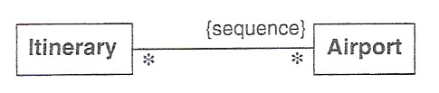
CS562WS DBMS II
CS574 Object-Oriented Analysis & Design
{sequence}
The following diagram introduces the notion of “{sequence}”
The intended association is something like “ConsistsOf,” so I’d draw the diagram as follows:
ConsistsOf

Slide 7
CS562WS DBMS II
CS574 Object-Oriented Analysis & Design
{sequence} (cont.)
Q. Since ordering implies a sequence, what is the difference between the two?
A. {ordered} doesn’t allow repetition; {sequence} does.
For example, in the diagram below, a specific airport can occur more than once in an itinerary, e.g., EWR -> ORD -> DIA -> SFO -> LAX -> EWR
ConsistsOf
So, the diagram says “an itinerary consists of a sequence of airports, possibly with repetitions, and an airport may be on zero or more, i.e., any number of, itineraries.”

Slide 8
CS562WS DBMS II
CS574 Object-Oriented Analysis & Design
{bag}
In mathematics a “bag” is, like a set, an unordered collection of items; it differs from a set in that a set can’t have the same element more than once, whereas a bag can.
{bag}
Person
*
*
Restaurant
EatsAt
The diagram above allows the application to record the fact that a person has eaten at a restaurant multiple times.

Slide 9
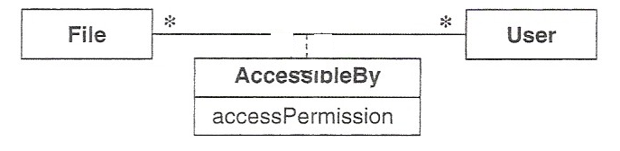
CS562WS DBMS II
CS574 Object-Oriented Analysis & Design
Association Classes
The authors of one textbook use the class diagram below to introduce the notion of an “association class.” For reasons already discussed, I think that the diagram is missing something critical. Before you go to the next slide, see if you can figure out what I’m talking about and try to fix it. (The diagram is for use in the file system component of some application.)

Slide 10
CS562WS DBMS II
CS574 Object-Oriented Analysis & Design
Association Classes (cont.)
I object to the fact that there’s no association name on the line between File and User. I’d change it to:
HasPermissionToAccess
The class that has been named “AccessibleBy” is called an association class because it’s a class each of whose instances contains some attributes of – and perhaps some operations relevant to – an association between an instance of File and an instance of User.
You can tell that it’s an association class because it looks like a class and it’s connected, by a dashed line, to the line that represents an association between two other classes.

Slide 11
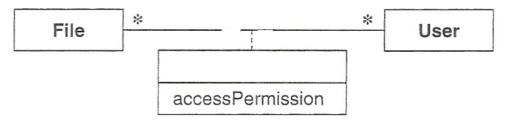
CS562WS DBMS II
CS574 Object-Oriented Analysis & Design
Association Classes (cont.)
Here’s how I’d draw the diagram:
HasPermissionToAccess
AccessPermissionDetails
I’ve changed the name of the association class to AccessPermisionDetails because that’s what its attributes are about and, presumably, what its operations operate on. (The values of accessPermission would likely be “read only,” “read and write,” and “write only.”)
In a real application AccessPermissionDetails would likely have additional attributes such as startDate, possibly password, and maybe others.

Slide 12
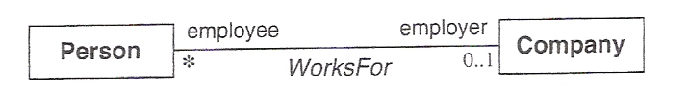
CS562WS DBMS II
CS574 Object-Oriented Analysis & Design
Association End Names
In many cases instances of the class at one or both ends of an association plays a role in the association that, if named on the class diagram, can help further explain what the association is about.
The diagram below uses the association end names “employee” and “employer” to indicate that an instance of Person works for an instance of Company, and that the instance of Person can be referred to as the employee and the instance of Company can be referred to as the employer. (I.e., “An employee person works for an employer company.”)

Slide 13
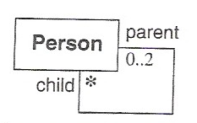
CS562WS DBMS II
CS574 Object-Oriented Analysis & Design
Association End Names (cont.)
When an association is between a class and itself – a recursive association – it is typically necessary to use association end names to make sense of multiplicities
For example, the class diagram below is trying to tell us that a parent Person is somehow associated with zero or more child Persons and that a child Person is somehow associated with between zero and two parent Persons
You may be able to guess what the person who drew the diagram had in mind, but the two diagrams on the next slide show two different things that the diagram might represent, so never draw an association without naming it…and name it in such way that virtually anyone will understand what it’s about!!!

Slide 14
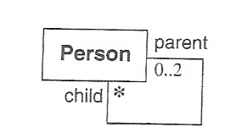
CS562WS DBMS II
CS574 Object-Oriented Analysis & Design
Association End Names (cont.)
IsAParentOf
IsCaringFor
The diagram on the right might occur in an application being designed for use by an organization involved in caring for the elderly.

Slide 15
Homework Part 1
CS562WS DBMS II
CS574 Object-Oriented Analysis & Design
Translate the ER diagram in the pdf file named CS574 HW1 Diagram into a UML class diagram. (In case you haven’t been exposed to ER diagrams before, read the file entitled Introduction to ER Diagrams.)
Submit your HW as a single Word or PPT file. (Multiple files will not be accepted, as they cause unnecessary administrative work.)

Slide 16
Homework Part 2
We will be using the industry-standard Unified Modeling Language (UML) notation -- plus English text -- in representing the results of our work, i.e. our analyses and designs.
Since you will be required to draw UML diagrams, you will need one of the many software tools that can be used for that purpose. (Drawing UML diagrams using a general purpose tool like Visio is also possible, if you prefer.)‏
There are many UML diagram drawing tools available for free on the web.
Some of them are: Visual Paradigm for UML; Argo UML; MagicDraw UML Community Edition; StarUML; JUDE (Java and UML Developers' Environment) community edition; and Altnova. There are probably quite a few others.

Slide 17
Homework Part 2 (cont.)
If you don’t already have a UML drawing tool, find and download one of the above, or do a search for freeware UML tools, and find one that works nicely on your computer
Be sure that the tool you use can draw class diagrams, use case diagrams, and sequence diagrams.
Any tool that lets you draw all of these is OK if it also allows you to copy diagrams in .jpg format and paste them into MS Word documents or .ppt documents – to submit in homeworks and exams.

